Slide 1
Chapter 2 – Distributed Systems Architecture
MERCY MAINA

Slide 2
Introduction
A distributed system architecture is a design where multiple independent computers (nodes) work as a single, unified system, sharing resources and coordinating tasks over a network to achieve common goals,
Key Benefits - spreading workloads instead of relying on one server.
  Scalability,
  Fault tolerance,
  High performance

Slide 3
Architectural Styles in DS
Distributed system architecture styles organize components into logical structures
  Client Server
  Peer –to-Peer (P2P)
  Layered
    3-Tier
    N-Tier
  Data Centic
  Service-Oriented Architecture (SOA)
  Event-Based/Event Driven
  Microservices

Slide 4
Architecture - categories
By Communication & Structure
  Client-Server:
  Peer-to-Peer (P2P):
  Three-Tier/N-Tier:
  Microservices:
  Service-Oriented Architecture (SOA):
  Event-Driven:
By Purpose & Deployment
  Distributed Computing Systems
  Distributed Information Systems
  Distributed Pervasive Systems
3. Other Architectures
Middleware-Based: Middleware acts as a bridge between different applications/OSs.
Shared-Nothing: Each node operates independently without sharing resources like memory or storage.

Slide 5
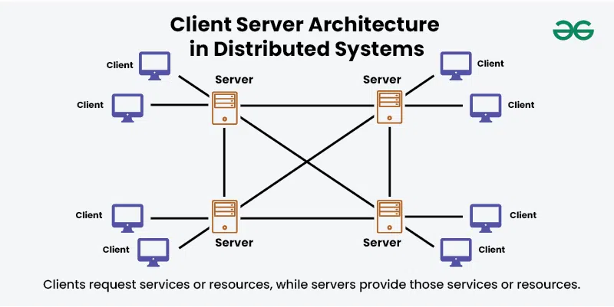
1. Client-server Architecture
Foundational model in distributed systems where the system is divided into two main components: clients and servers.
This architecture defines how tasks and services are distributed across different entities within a network.

Slide 6
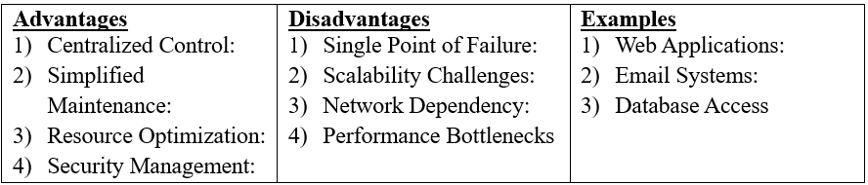
Client Server…… /2
Key Principles
  Separation of Concerns:
  Centralized Management:
  Request-Response Model:
  Scalability
  Security:

Slide 7
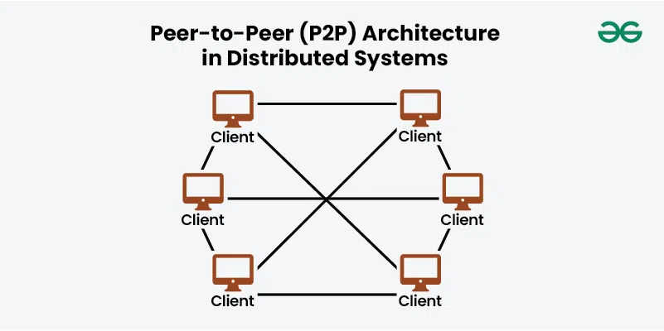
2. Peer-to-Peer (P2P) Architecture
Decentralized network design where each node, or "peer," acts as both a client and a server, contributing resources and services to the network

Slide 8
Peer – to - Peer…… /2
Key Features – Decentralization, Resource Sharing,
Scalability and Self Organization
2. Advantages
  Fault Tolerance:
  Cost Efficiency:
  Scalability:
3. Disadvantages
  Security:
  Performance Variability:
  Complexity:.
4. Example
  File Sharing Networks:
  Decentralized Applications (DApps):

Slide 9
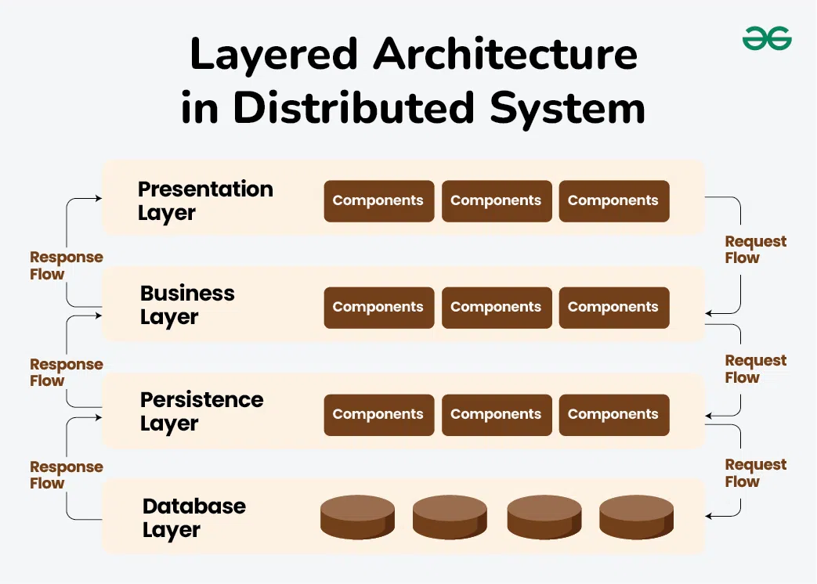
3. Layered Architecture -
Organized into hierarchical layers, each with specific functions and responsibilities

Slide 10
Layered Architecture …../2
Three – Tier Architecture (Standard)
  Presentation Tier: User interface (Web browser, mobile app).
  Logic Tier: Processes business rules, calculations, and data validation.
  Data Tier: Database management system storing persistent data.
N-Tier Architecture (Multitier)
  Any distributed application with more than one tier, often used when more than three layers are needed.
  Components: Adds extra layers between the presentation and data layers, such as specialized application servers, web services, or security layers.

Slide 11
Layered Architecture – Advantages/Disadvantages
Advantages
  Separation of Concerns:
  Modularity:
  Reusability:
  Scalability:
Disadvantages
  Performance Overhead:
  Complexity:
  Rigidity:
Examples
  Web Applications
  Enterprise Systems

Slide 12
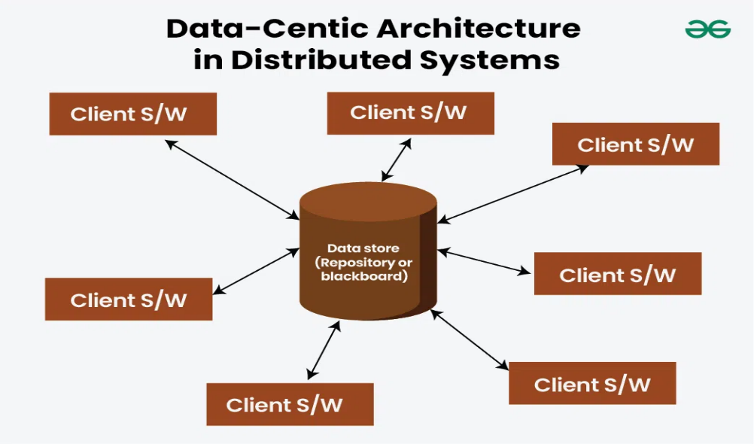
4. Data-Centic Architecture
Architectural style that focuses on the central management and utilization of data
Data taken as critical asset – Primary concern

Slide 13
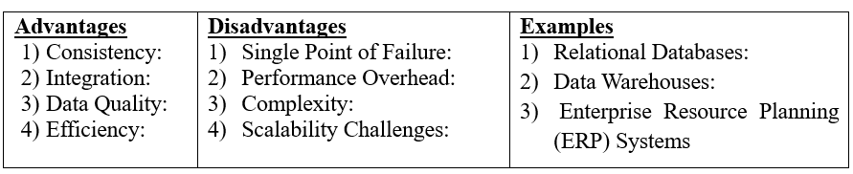
Data Centic Architecture …../2
Key Aspects
  Centralized Data Management
  Data Abstraction
  Data Normalization:
  Data Integration:
  Scalability and Performance:

Slide 14
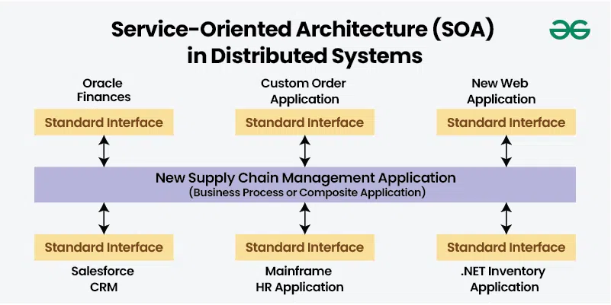
4. Service-Oriented Architecture (SOA)
Design paradigm in distributed systems where software components, known as "services," are provided and consumed across a network

Slide 15
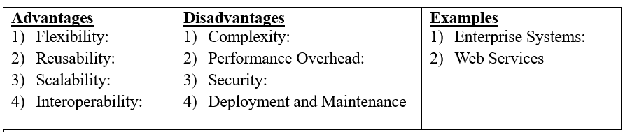
Service-Oriented Architecture (SOA) …./2
Key Principles
  Loose Coupling:
  Service Reusability:
  Interoperability:
  Discoverability:
  Abstraction:

Slide 16
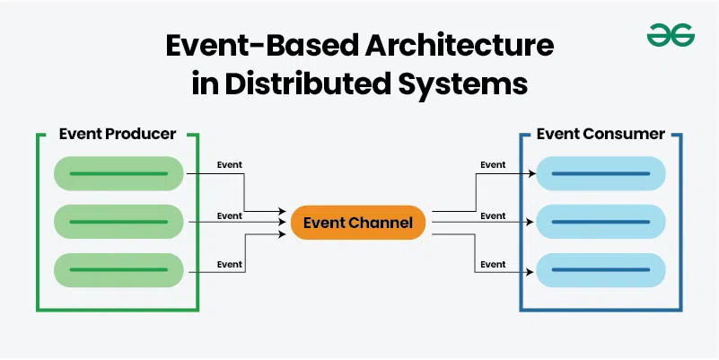
5. Event-Based/ Driven Architecture in Distributed Systems
Event-Driven Architecture (EDA) is an architectural pattern where the flow of data and control in a system is driven by events

Slide 17
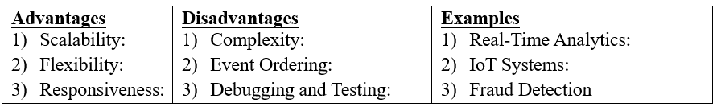
Event-Based/Driven Architecture (EDA) …./2
Key Principles
  Event Producers:
  Event Consumers:
  Event Channels:
  Loose Coupling

Slide 18
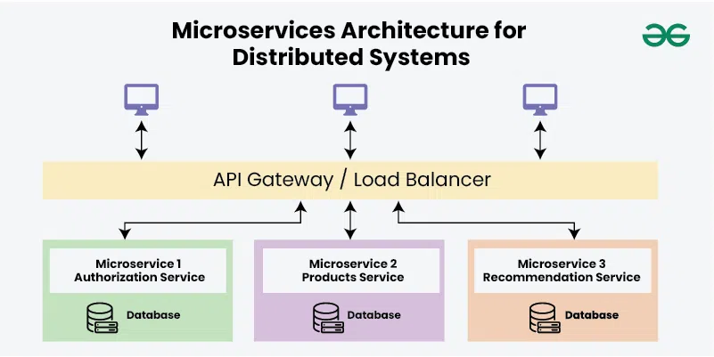
6. Microservices Architecture for Distributed Systems
A design pattern where an application is composed of small, independent services that each perform a specific function. These services are loosely coupled and interact with each other through lightweight communication protocols, often over HTTP or messaging queues.

Slide 19
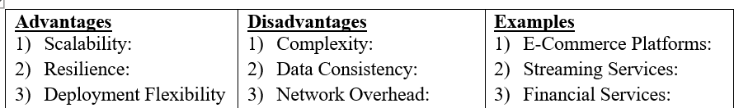
Microservices Architecture …./2
Key Principles
  Single Responsibility:
  Autonomy:
  Decentralized Data Management:
  Inter-service Communication:

Slide 20
Architecture - Design principles
Scalability:
  Horizontal scalability
  Vertical scalability:
Fault tolerance
Replication:
Checkpoints:
Failover
Heterogeneity: .
Openness:
Security:
Failure handling

Slide 21
Architecture - Design principles …./2
10. Concurrency:
11. Transparency
    Location transparency:
    Migration transparency:
    Replication transparency:
    Concurrency transparency:
    Parallelism transparency:
12. Quality of service:
13. Reliability:
14. Performance:

Slide 22
Question and Answers
End

